Slide 1
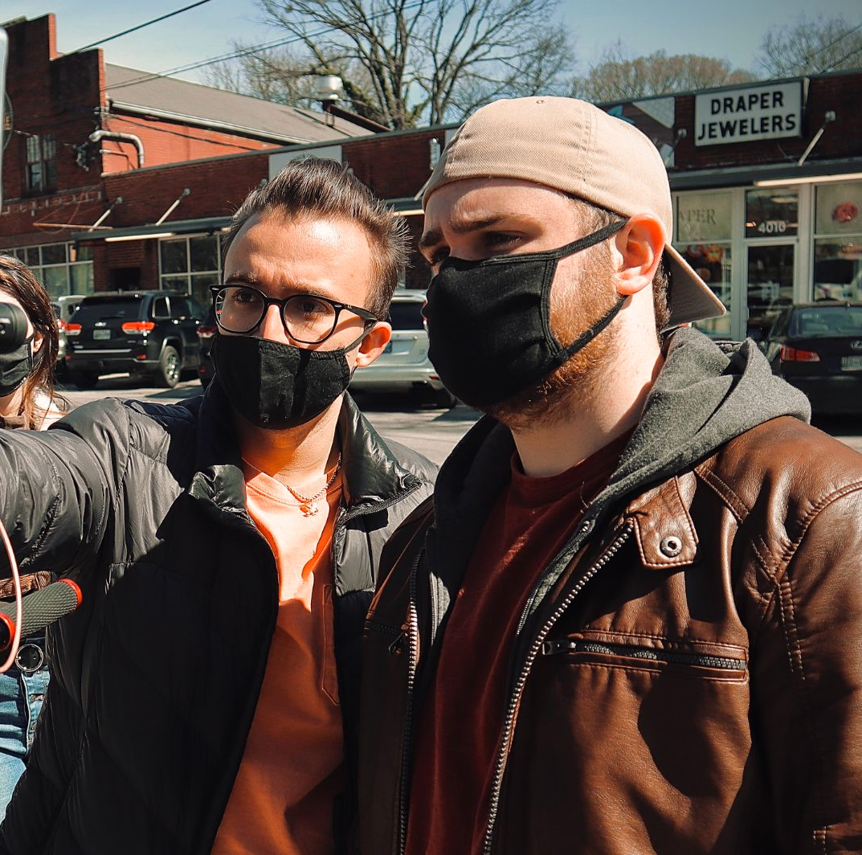
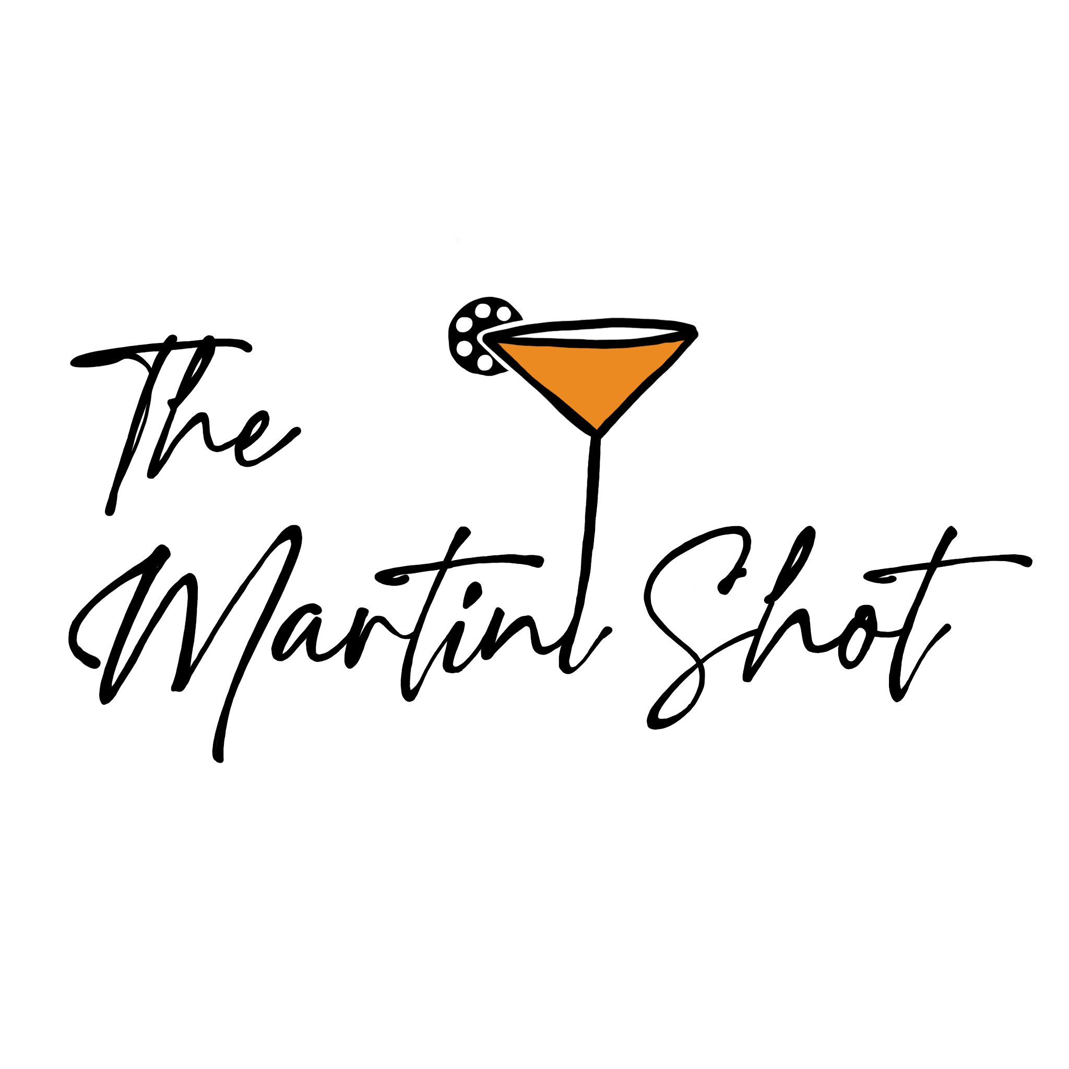
LIAM STENSON
Notes:
When I originally thought about what I wanted to do with this campaign, I settled on something near and dear to my heart, and that was the Martini Shot: a free-form podcast style channel that would talk about nearly anything pertaining to the film industry. I wanted to create a forum for anyone to share their thoughts and opinions with me about movies they love, gossip they hear, and stories they want to create. Through blog and podcast format, I believe I have successfully captured that vision.

Slide 2
reasoning for course
Notes:
I took this course originally for two simple reasons. Education, and the future (jobs).
I wanted to learn more about social media, how to manage it effectively through different channels and different mediums. I wanted to learn what it would be like to manage a brand, to spread content and be able to foster a community using information and technology as resources to that campaign.
I needed a class that would empower me to start my own brand, and company that could one day be profitable… because it is so valuable to me. I want to one day make a living off of social media creation, if I could even own a side business/side hustle that would allow me to pull in money.

Slide 3
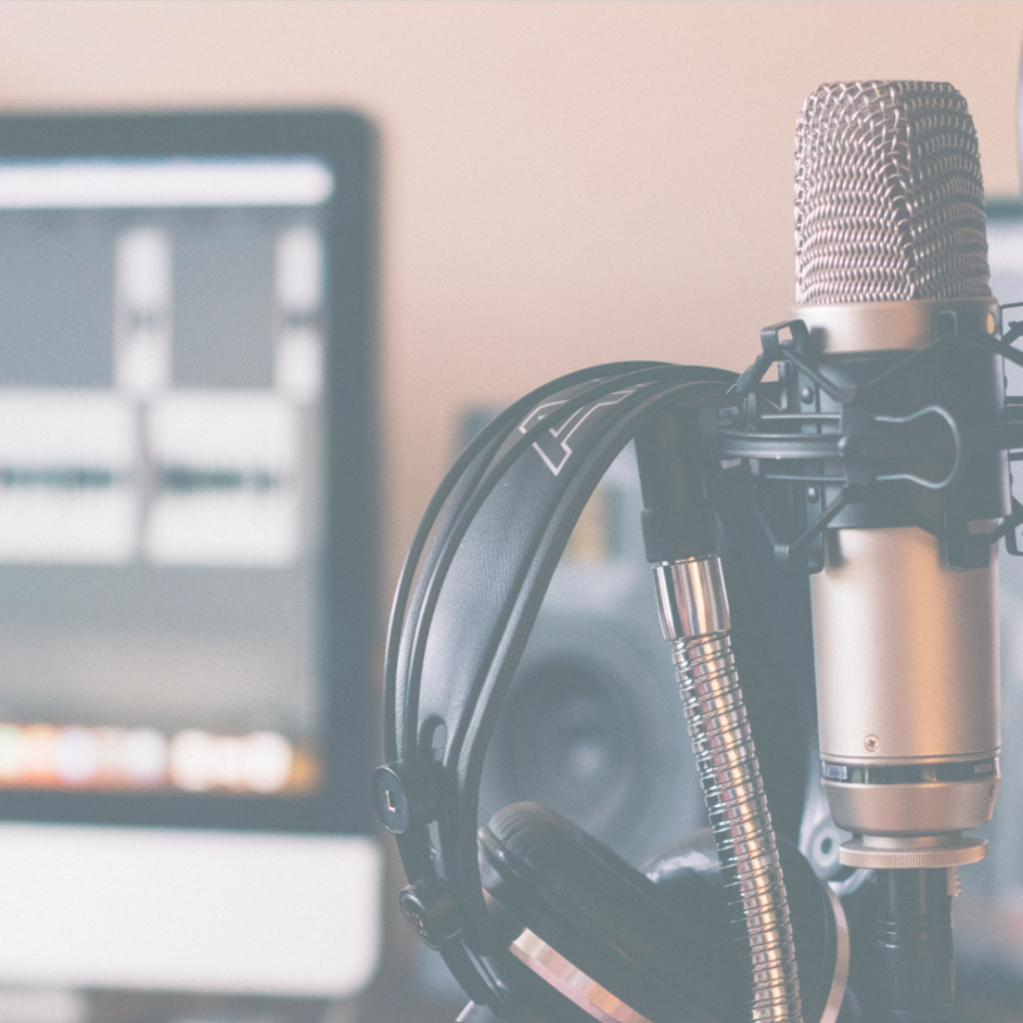
expectations
My expectations for this class were to build a brand under the guise of social media. Foster our talents through there and then spread information daily through the likes of Instagram, Snapchat, LinkedIn, TikTok, and Facebook.
Notes:
There is no content for this section other than the material already provided.

Slide 4
results
“At the end of the day, you can't control the results; you can only control your effort level and your focus.”
Ben Zobrist
Notes:
This class turned out, not how I had originally thought it would. We curated content, we spread information through social media, and we fostered our talents, all like I had expected, but to a different degree. We never were really taught anything special about Instagram, Facebook, or TikTok. We never learned how to actually “Market” via social media, and we never taught how to post information effectively through these different mediums… we were pretty much left to our own devices on that front. We were taught how to write and curate a blog, and how to send out an email campaign, but that was pretty much the extent of our marketing lessons in social media. I expected a class that would take into consideration more hands-on approaches in how we run our Instagram or Facebook pages, and was shocked not to see this when taking the class.

Slide 5
s.w.o.t
decline in subscribers (higher unsubscriptions)
strengths
weaknesses
customer/user interface
one of the highest statistics (high pageviews, users, goal comp., etc.
more posts via social media
opportunities
threats
social media presence
podcasting is highly competitive and requires a lot of work
Notes:
Strengths
Looking at the other students in my class, I can tell that our strengths previously still held true today. The Martini Shot continues to hold up a superior consumer interface. Our website is still very strong, and we even updated it to make it more seamless for our visitors. We have fewer tabs, fewer options, and a much more streamlined approach on our homepage. Of course, all of these pages are still there — they’re just hidden. While they still have the option to read our blog, listen to our podcast, and to interact with our content via forms, and comments, all of this is much more in sync with our brand, and kept hidden in order to prevent first-time users from feeling overwhelmed. As we continue to grow, our numbers speak for themselves. Out of the entire class, we continue to have the most subscribers, the most visitors (users), the most sessions, and the most interactions (goal completions). Of course, that last one may be because we just ran a promotion on our website, where we gave away $10, but who is to say?
Weaknesses
When it comes to our weaknesses, we do have a few… however, the list has gotten smaller over recent weeks. While we have amped up our email attendance/click-throughs and opens, we begin to see a decline in our subscribers (they are unsubscribing!). Due to the sheer amount of emails that are required of us to send this semester, my subscribers are getting frustrated. They do not like the constant reach-outs and beg for attention. They are beginning to get annoyed, and hence, they unsubscribe. If there were fewer required emails from the students in this campaign, there would be less subscription loss and more retention in our consumers each week.
Opportunities
Again, The Martini Shot continuously does a great job with their website and content creation. They continue to set the bar, time and time again, especially compared to some of their competitors in this course. While this campaign is coming to a close, there is not much more room for growth or opportunities. We, however, could see a better design in our Instagram/social media feed. We could post more on our social media, tag more creators for a bigger turnout in users, and maybe even post more constantly. With regularly scheduled content (both on our website (blogs) and our social channels (posts)) we think we could turn out a bigger crowd, segmenting a bigger audience and increasing our statistics in the process.
Threats
With us placing a large emphasis on our blog and website, we sort of lost track of social media, and forgot to post a couple of times (more often than not). Our constant threat is that we were always lower on the totem pole for spreading the word out to our subscribers and followers. While other classmates were constantly posting about their campaigns we were, but not as much. For every three posts they put out, we only posted about once. We definitely need to reconsider our stance here and drive home a better social media presence to speak for our content. However, while our social media presence was weak, we did still have a fair number of users/new users coming from that form of acquisition. Additionally, after putting out only one episode of our podcast, we realized it was going to be a lot of work to make 15 of them by the end of the campaign. Not only is it highly sought after (especially if your topic on podcasts is about the film industry), but it’s a very hard medium to undertake and requires lots and lots of work to get exactly right.

Slide 6
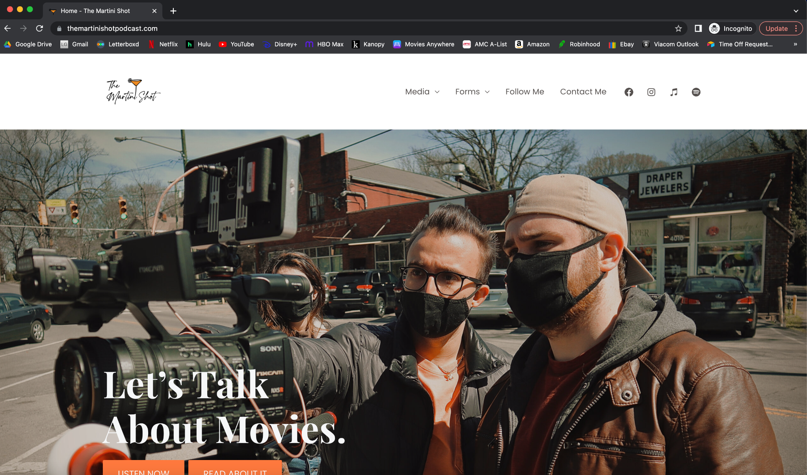
aesthetics
Notes:
With the help of some online plugins and templates, I was able to curate a website that would visually pop and provide detail about who I am and what I want to share. From the first page alone, you are able to read about who I am, our most recent blog post, and see what it is that we do.

Slide 7
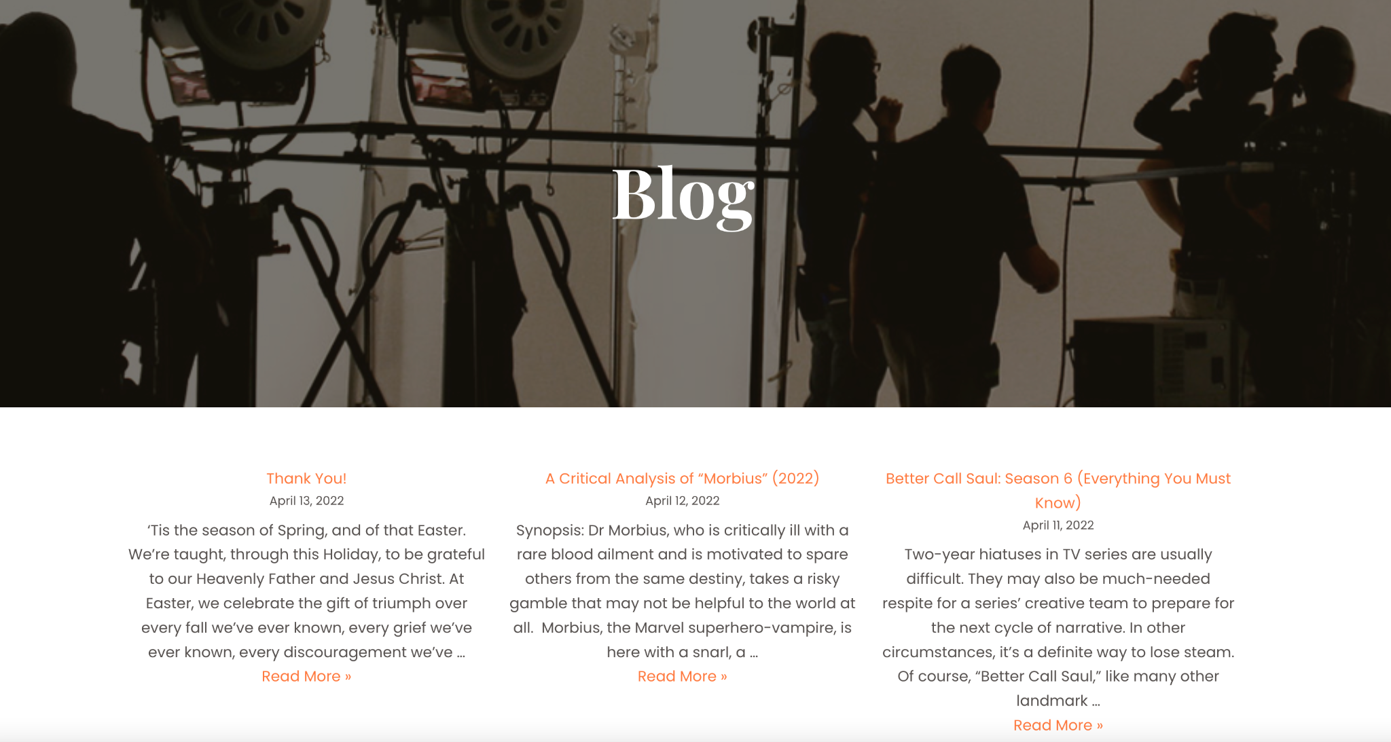
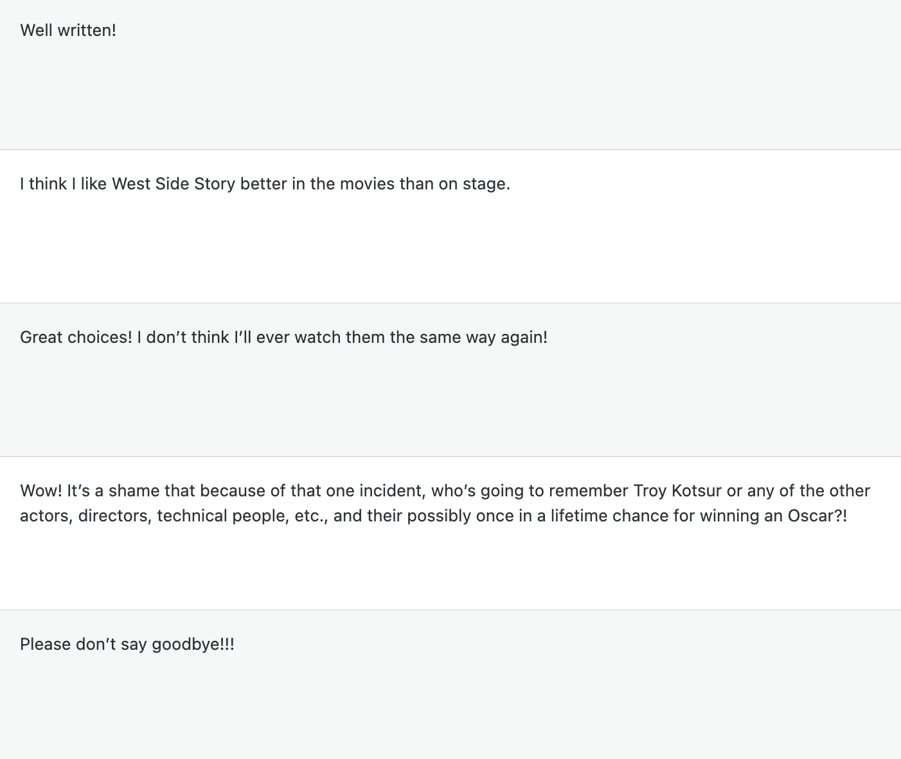
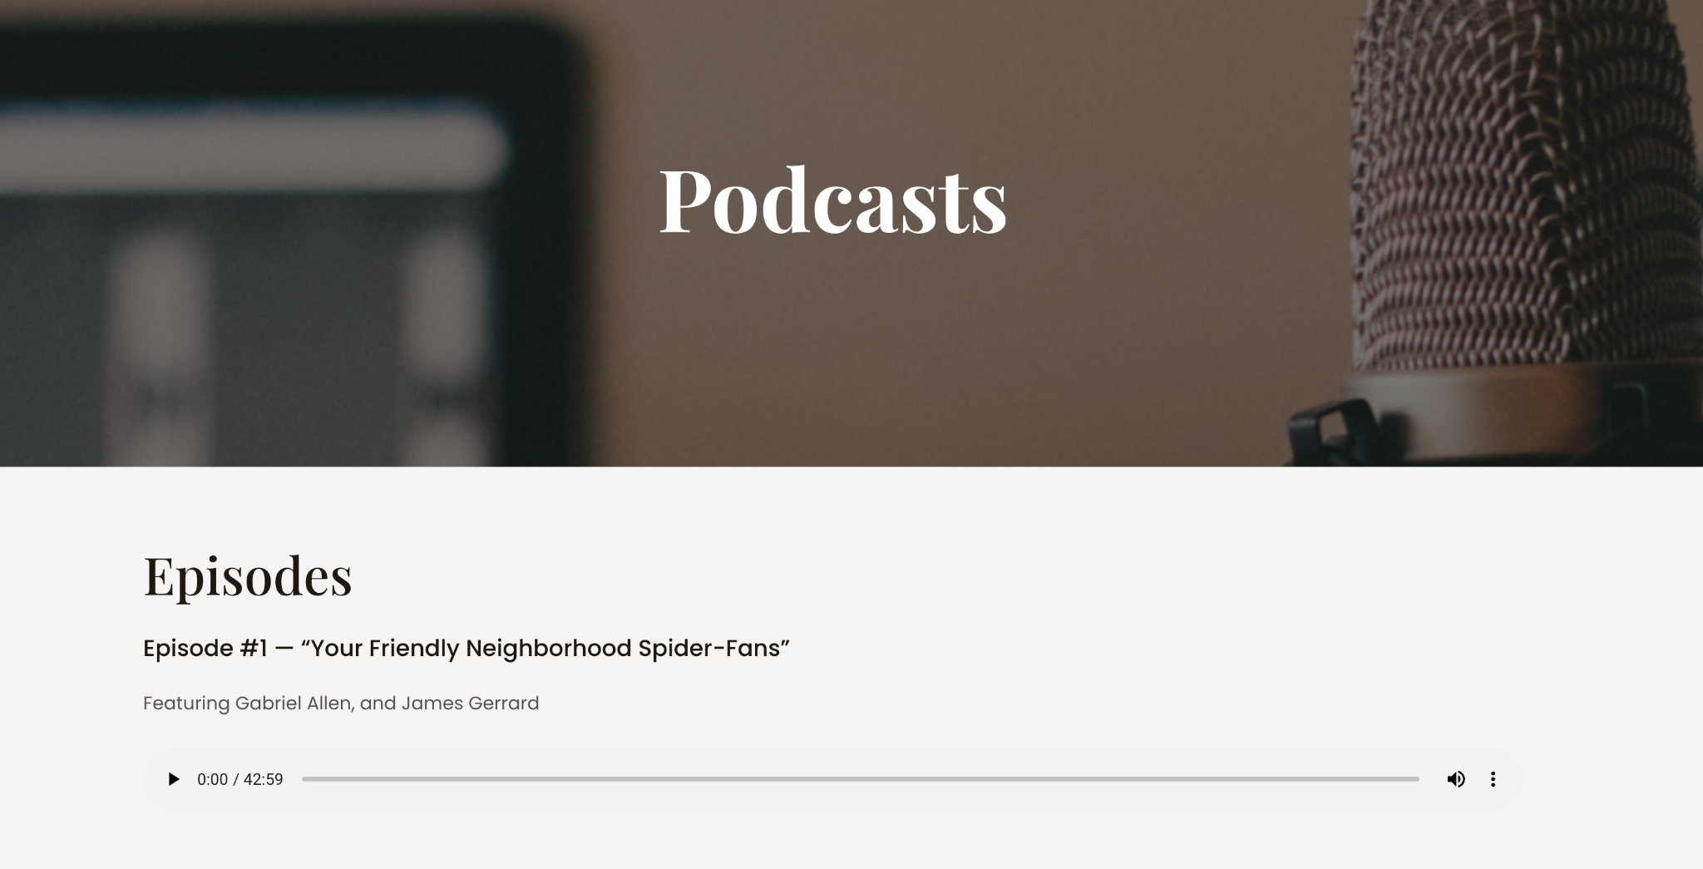
our successful blog
JUST A FEW COMMENTS ↑
Notes:
Our blog was the reason for a majority of our success. Each week, we would foster new content that would pertain to the film industry. Whether this was a new podcast episode, a blog about Will Smith’s slap, or a movie review, we would always be here to entertain our audience members. As our campaign shifted and transitioned many a-times throughout the eight-weeks, so did our audience. They learned to adapt with our style, and our communication, and even wrote back to us. We had plenty of positive and supportive comments, and you can see more of them on our website! (These are just a few to our right.)

Slide 8
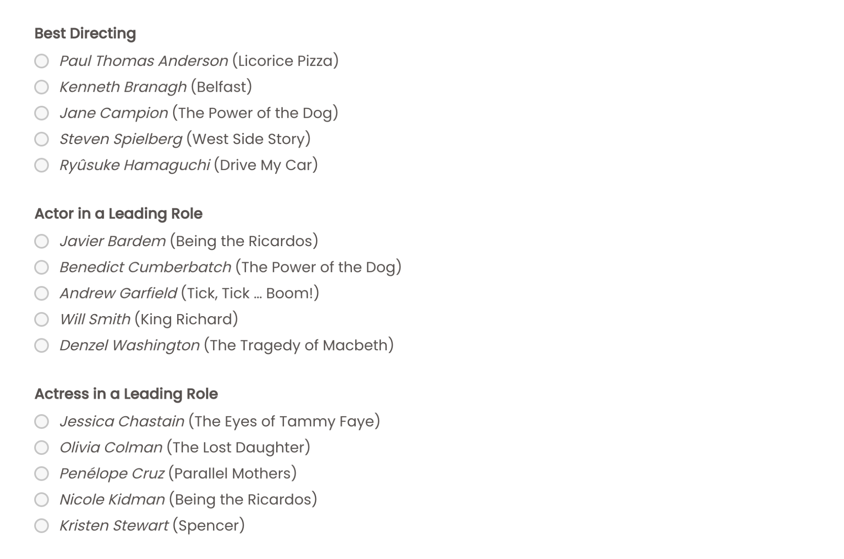
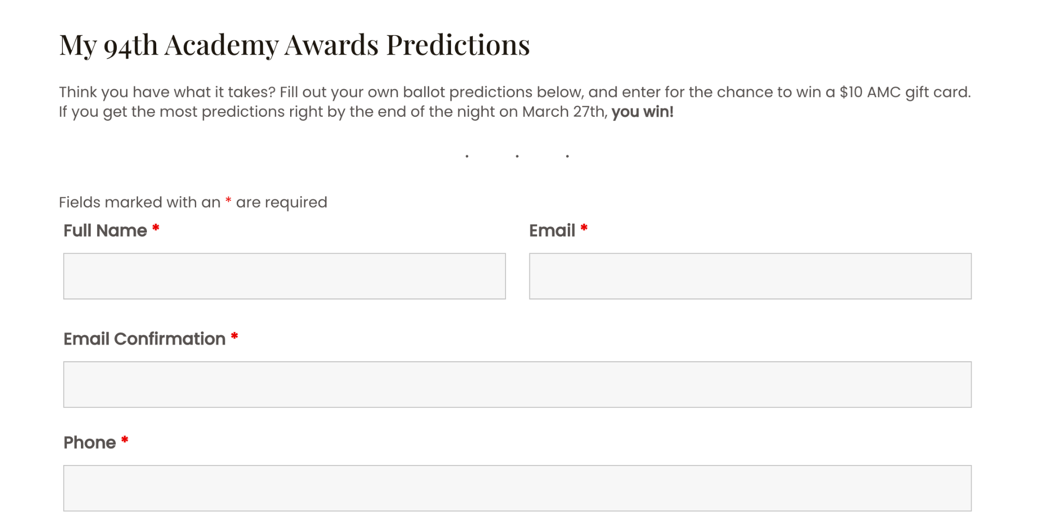
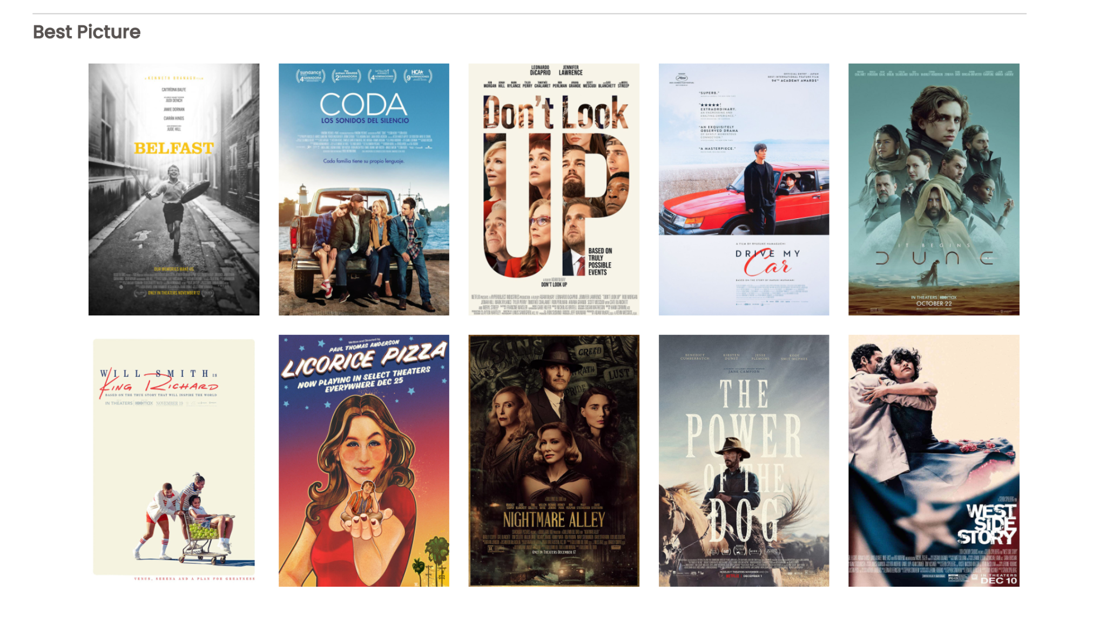
the gift card campaign
Notes:
In attempt to increase our user turnout, and have a more successful campaign, we ran a 5-day mini-campaign in which we asked our audience members (via social media, email and in-person) to fill out their Oscar ballots. By submitting “their predictions” they were entered in for a chance to win a $10 AMC movie gift card. We thought it would be nice, as it would not only turn-out better numbers/statistics for us, but also get our audience out there to go see more movies (it’s a win-win). Whoever got the highest score right (on their ballots) and correctly guessed all the winning categories, would win the $10 AMC gift card. What we saw was overall success, both via our Acquisitions and our Goal Completions.

Slide 9
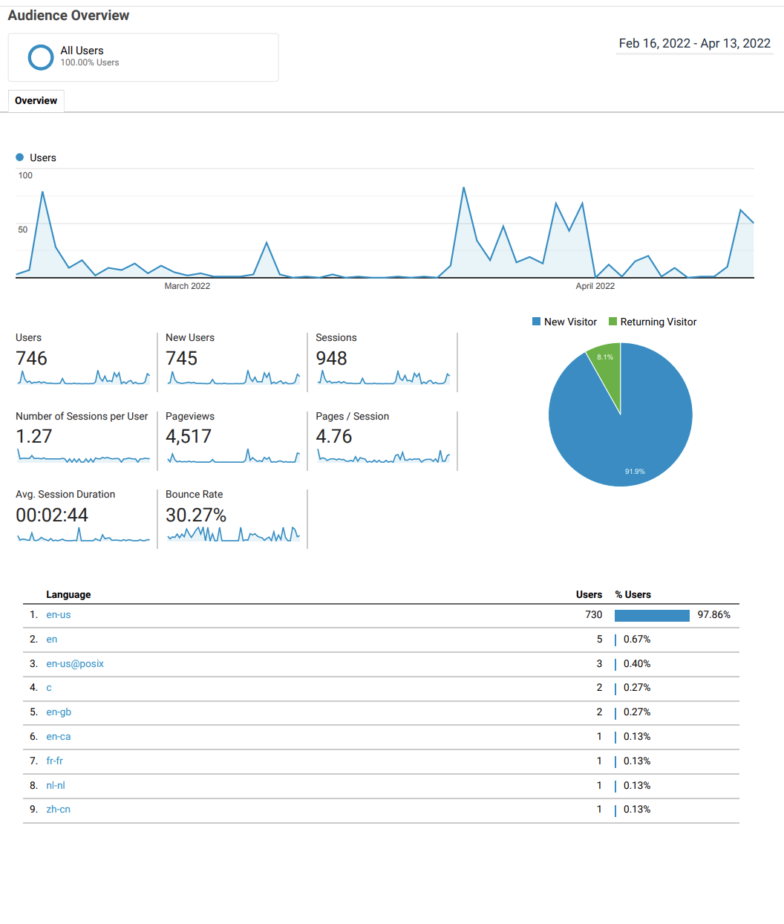
google analytics
Notes:
Important Info
4,517 pageviews
948 Sessions
746 Users
The first spike is from the campaign’s launch
The wave halfway through the campaign was our “My Predictions” gift card campaign

Slide 10
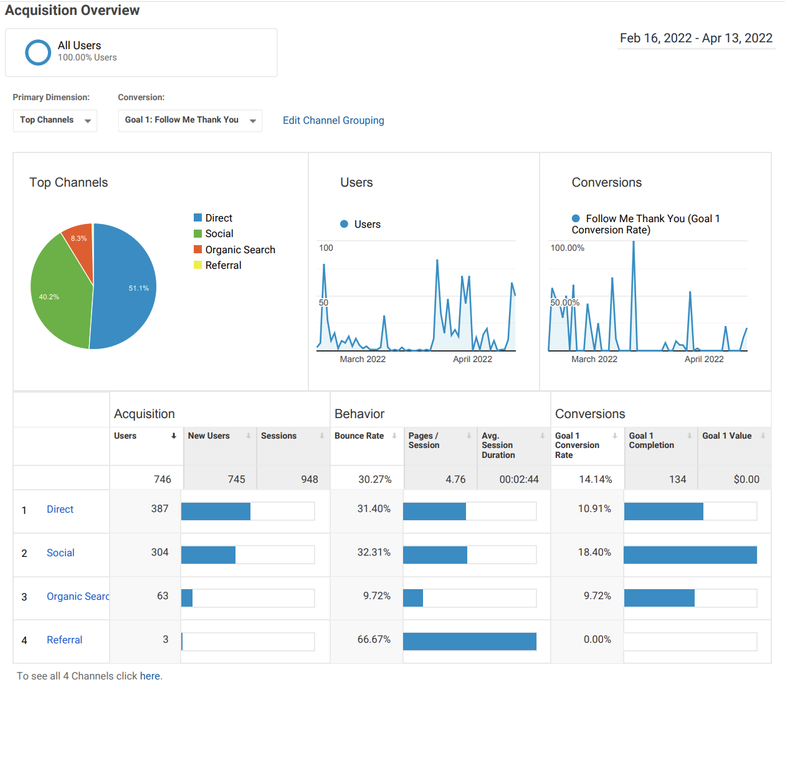
google analytics
Notes:
Important Info
51.1% of users were direct
40.2% of users were from social
Meaning that we have a 8.2% of users who found our site organically!

Slide 11
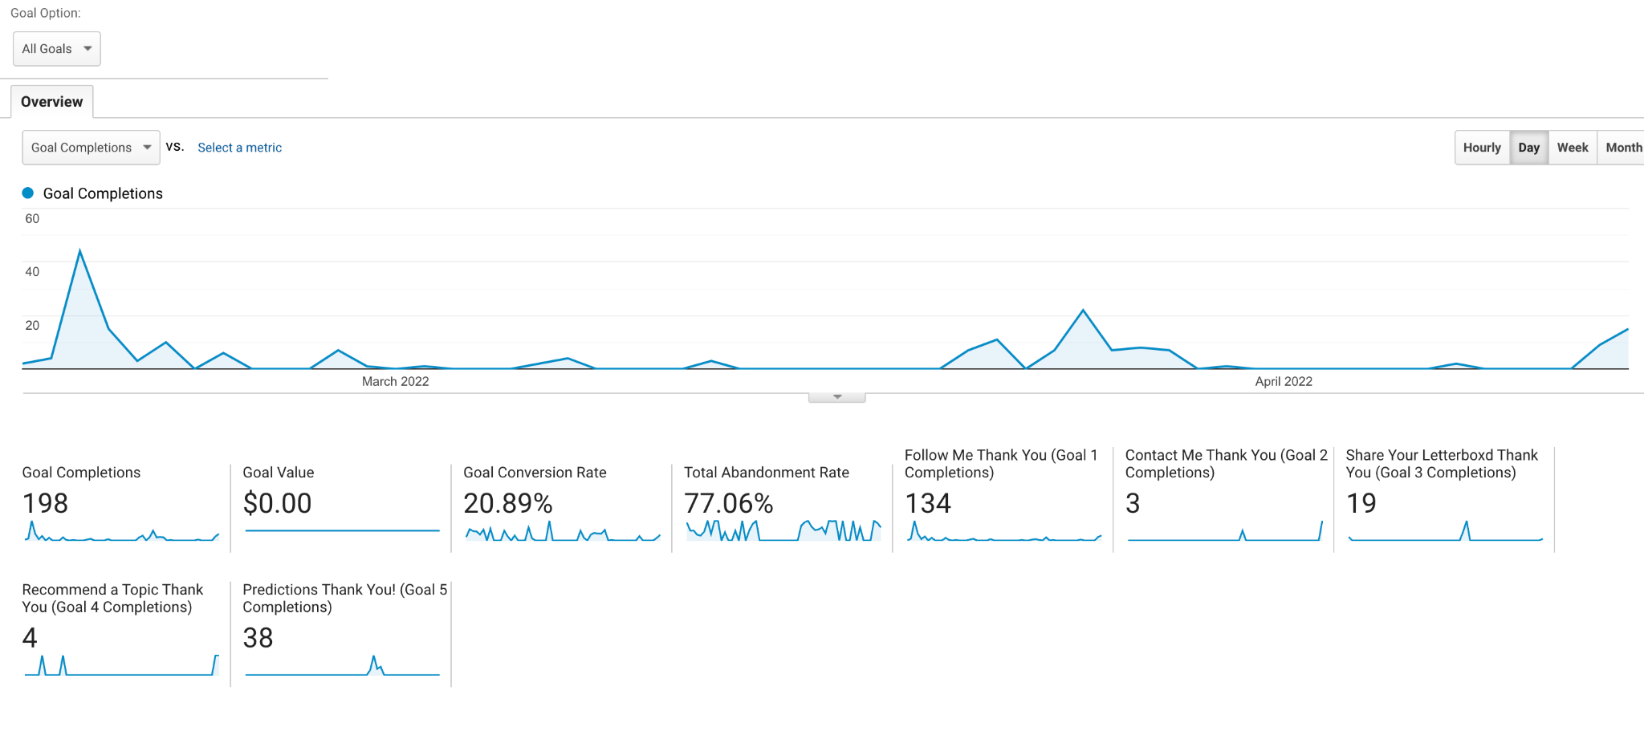
google analytics
Notes:
Important Info
198 goal completions, one of the highest out of all my classmates, if not the highest goal completion count

Slide 12
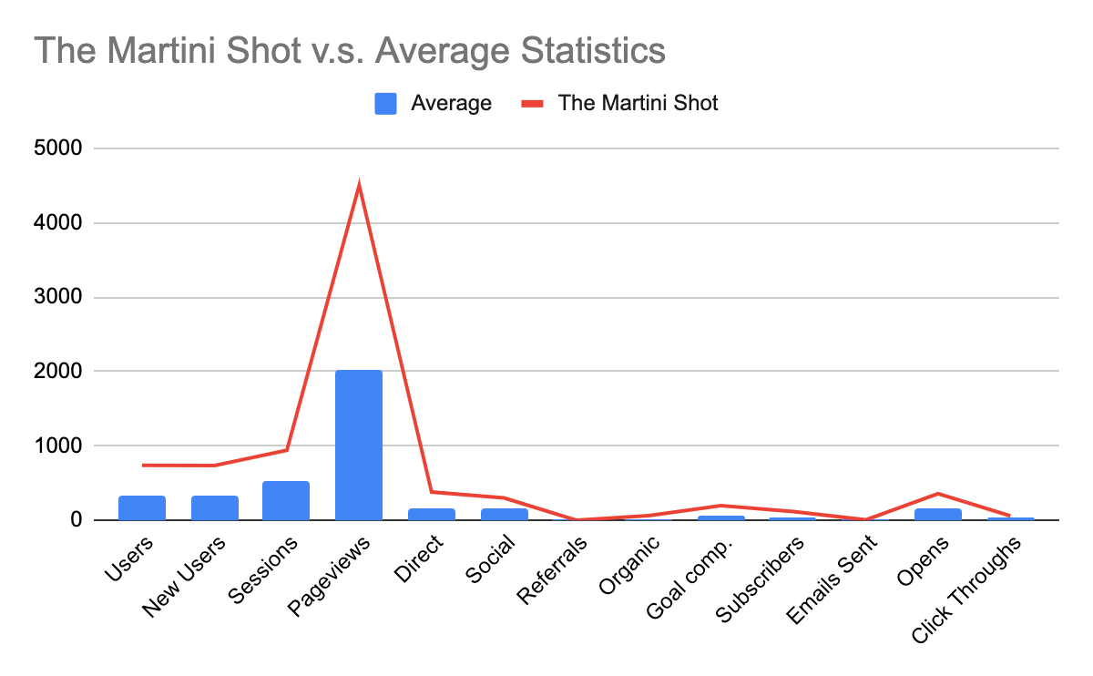
class analytics
Notes:
The Martini Shot was very successful in their campaign as they were always above average in nearly all of the categories assigned via this chart. Compared to my classmates, I was also able to hit the right market and my ability to connect and establish a relationship with my audience and this brand was impeccable. One standout to note, is that we had a lot of audience, nearly doubling the average number of users and pageviews in our campaign.

Slide 13
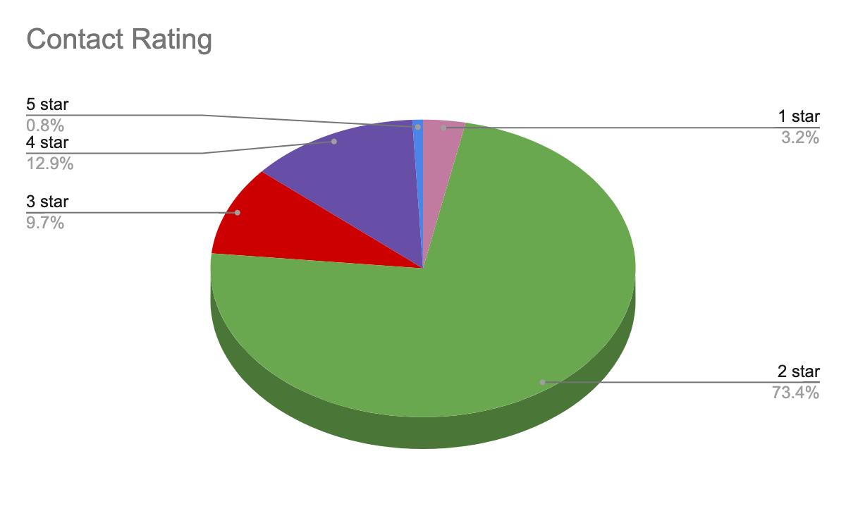
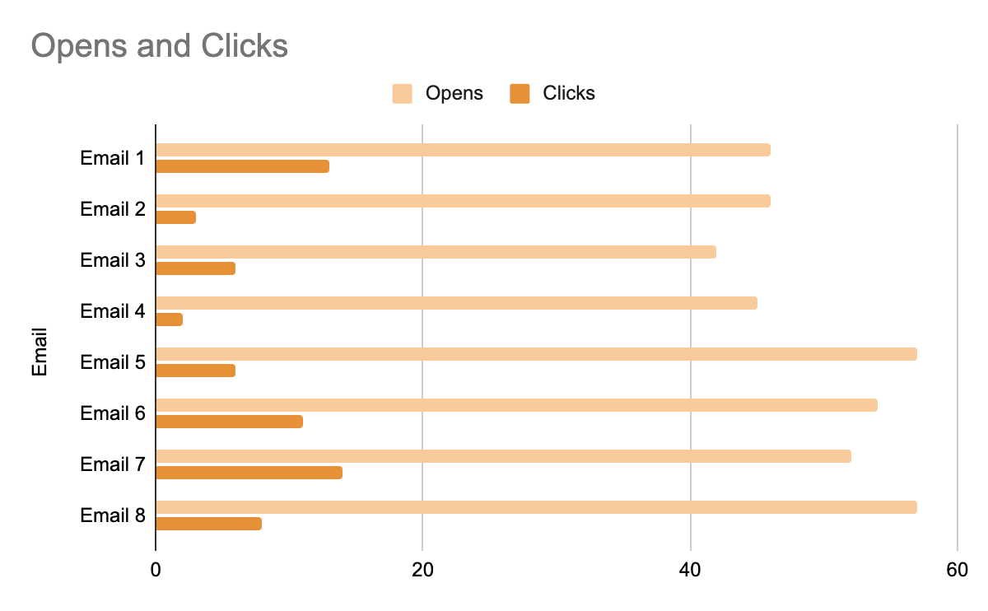
mailchimp analytics
124 Contacts
118 Subscribers
Notes:
Important Info
124 contacts
118 subscribers
of those, that means we had 6 people’s emails bounce
We had multiple unsubscribers
Contact Rating was mediocre
We had 91 contacts with a 2 star rating
That means nearly 75% of our contacts were just clicking on our emails, not going any further than to read them. They didn't click on our hyperlinks to our website or communicate with/contact us

Slide 14
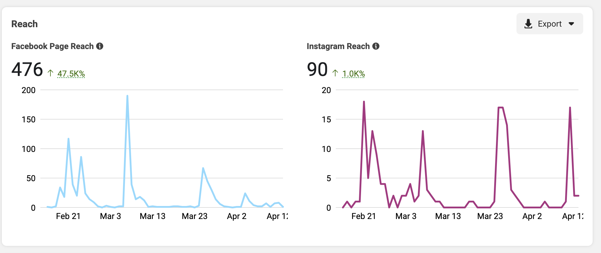
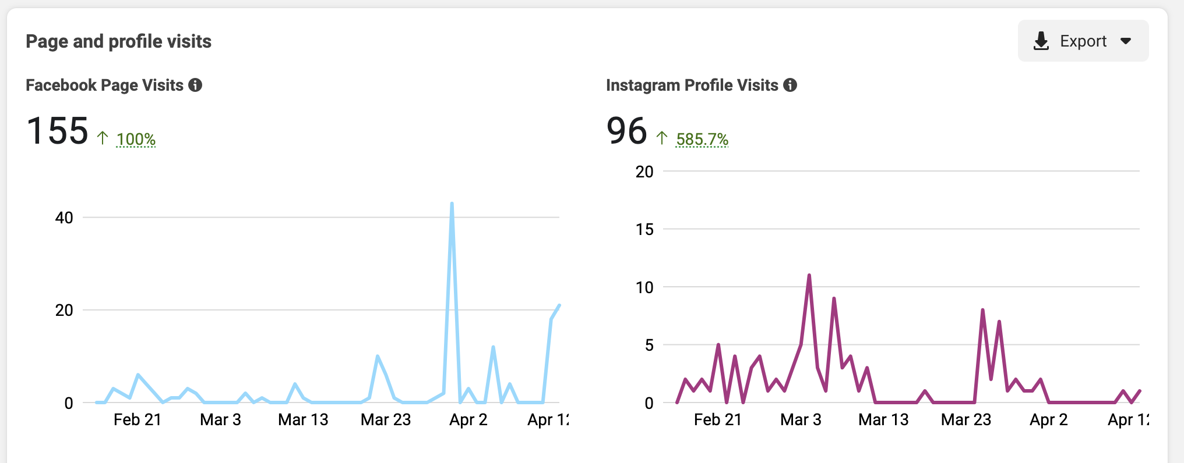
facebook & instagram
analytics
Notes:
Important Info
Big spike in page visits from Facebook after the “My predictions” gift card campaign
Page Reaches
Facebook: 476
Insta: 90
Profile or Page visits
Facebook: 155
Insta: 96

Slide 15
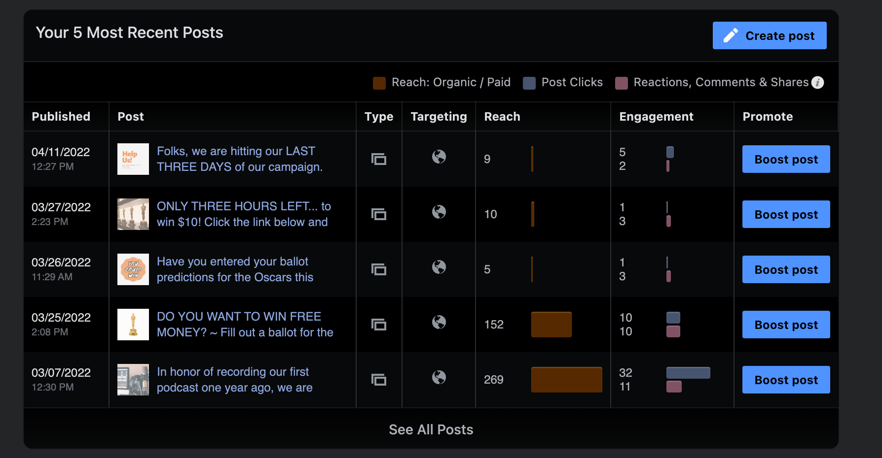
facebook & instagram
analytics
19 Page Likes on Facebook
60 Followers on Instagram
Notes:
Important Info
269 people reached out to from one of our posts
Our most interactions from a post on our social media
19 page likes on Facebook
60 followers on Instagram

Slide 16
overview
Notes:
Overall, this class provided me with the knowledge and onset to accurately advertise and market a campaign. I’ve developed a richer appreciation for blog content curation, email marketing, and public relations/advertising. While we didn’t focus too much on social media, or how to manage it within our own campaigns, I believe the real goal of the class was to establish a brand and successfully spread the word with the intention to market and drain it’s resources for lead generation. While I get ready to head off into the real world, this class has taught me numerous applications and software skills I never thought I would possess and for that, I am incredibly grateful.

